Slide 1

Modded Motor Market
A path to German excellence
Developers:
Ashley Fram
Matthew Fulwood-Benbow
Evan Ezeobinwa
Schilosson Chauvet
Khadijah Shamim

Slide 2
Team Members and Roles
Ashley Fram: APIs, Script, and Database
Matthew Fulwood-Benbow: JavaScript
Evan Ezeobinwa: HTML/CSS
Schilosson Chauvet: JavaScript
Khadijah Shamim: HTML/CSS
Disclosure: We all worked on a bit of everything, though we did have assigned roles (see left), it was easier for us to each do as much as we could within each category to complete the project.
We all did the PowerPoint Presentation and Final Write-Up

Slide 3
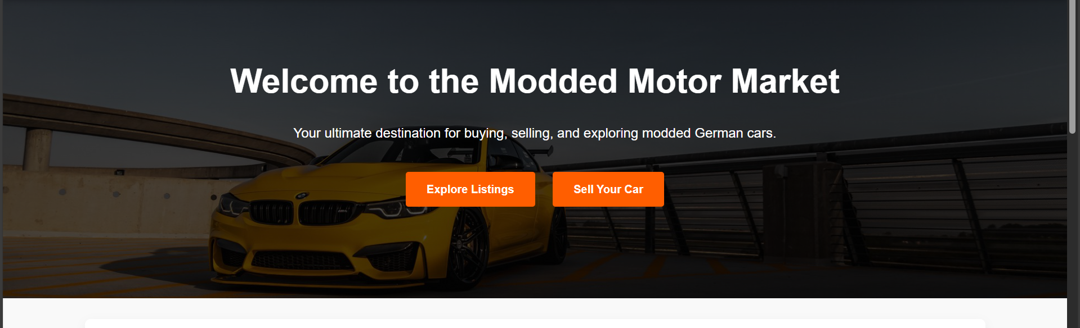
What is our Project?
Our project is an online marketplace specifically tailored for buying and selling German modded cars
Our website was inspired by platforms like Autotrader and Facebook Marketplace but with a niche focus on enthusiast-owned German vehicles.
The domain revolves around the automotive market, particularly modified German models such as BMW, Mercedes, Audi, Volkswagen, and Porsche, which are popular among car enthusiasts for their performance and customization potential.

Slide 4
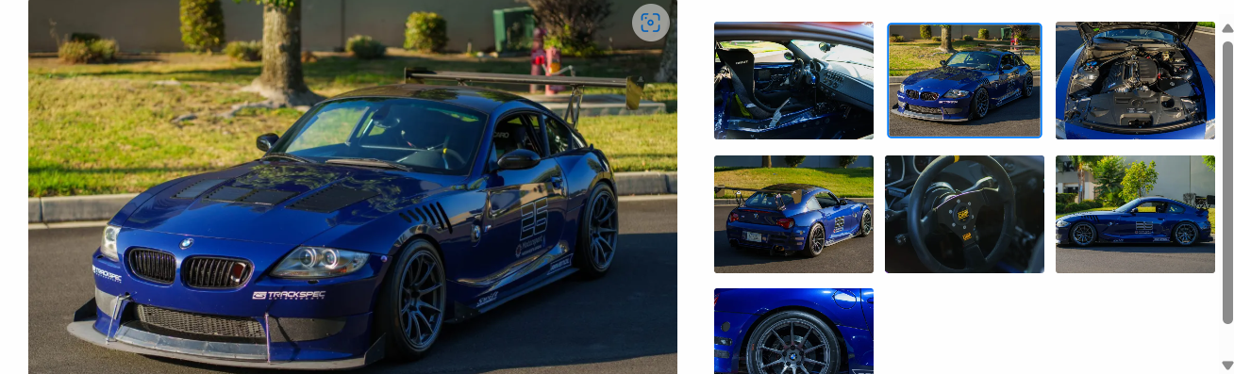
Why Did We Choose This?
All of us have an appreciation of cars and automobile culture, which is what drew us to this domain
We find it fascinating how these cars can be customized with tuning and aftermarket components.
Our original plan was to create a marketplace for all car brands, which we very quickly deemed as way too much data for this project, so we all concluded to focus on German engineering.
To facilitate the purchasing and selling of modified automobiles, we developed a specialized platform that would allow individuals to quickly find well-documented builds while establishing a community around common automotive interests.

Slide 5
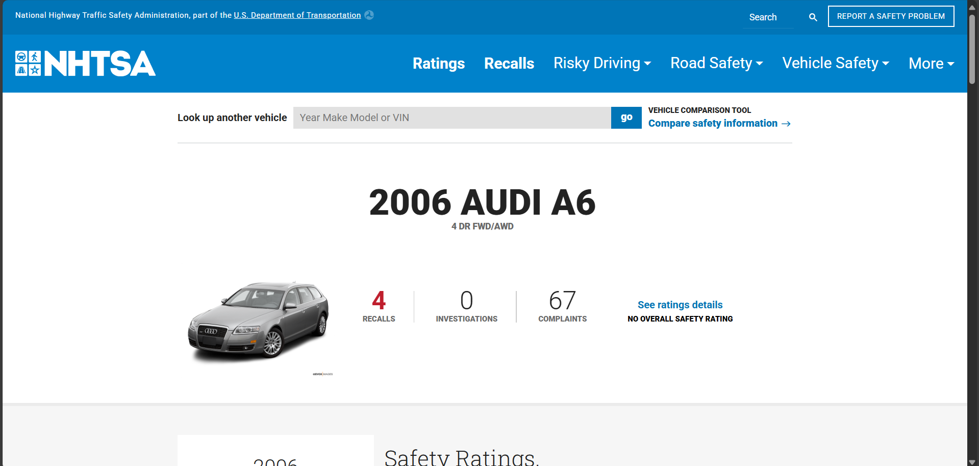
Software used
Frontend:
HTML/CSS/JavaScript – Core structure, styling, and interactivity.
Replit IDE – Used for rapid development, testing, and deployment.
Backend:
Node.js (with Express.js) – Handled server logic, API routing, and authentication.
Database:
SQLite3 – Lightweight relational database for storing user accounts, car listings, and modification details.
Authentication:
OAuth (Google login) – Optional social login for streamlined sign-ups.
External APIs:
NHTSA (National Highway Traffic Safety Administration) Recall API – Integrated to display recall alerts on car listings, improving buyer awareness.

Slide 6
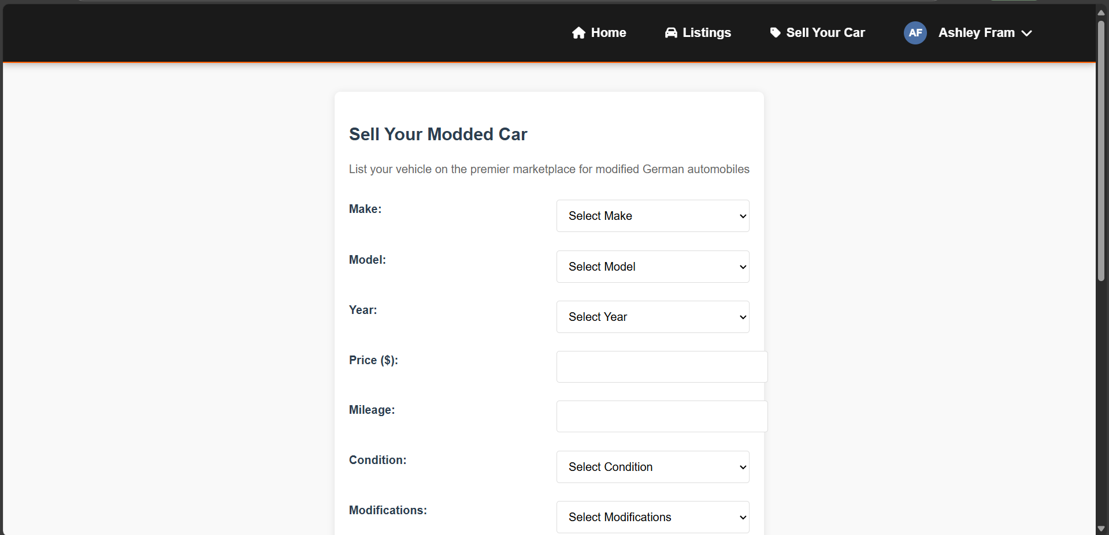
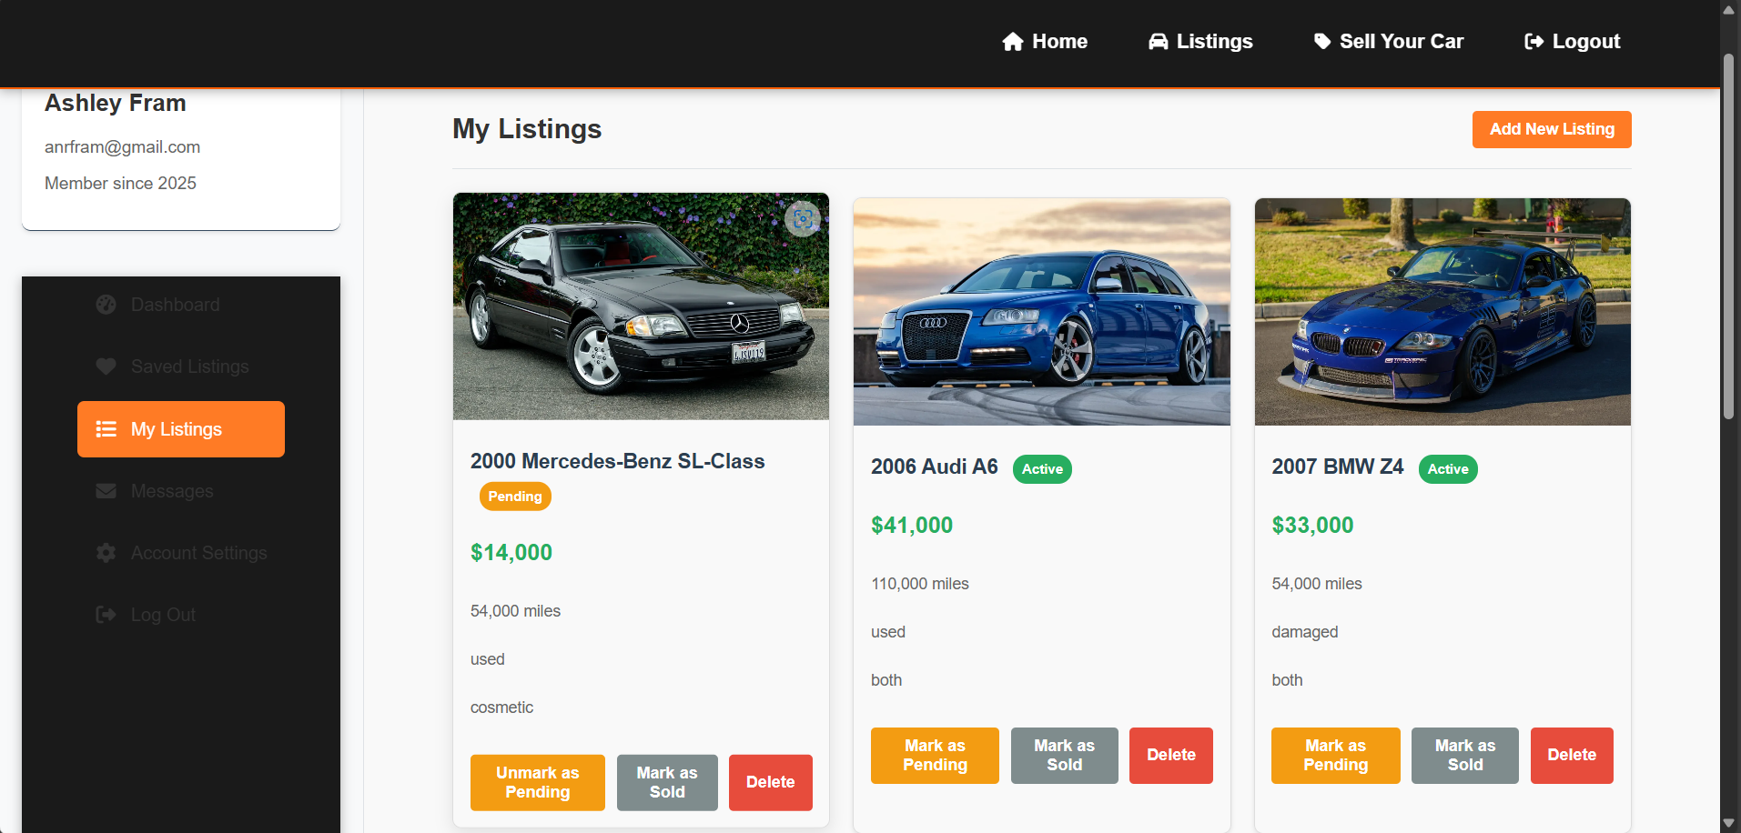
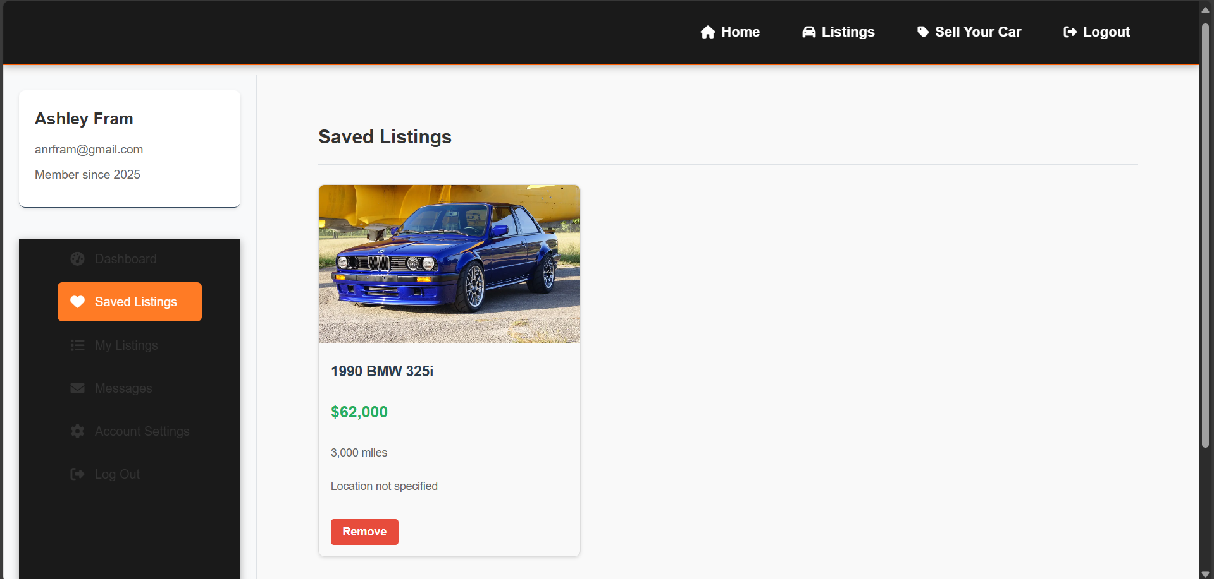
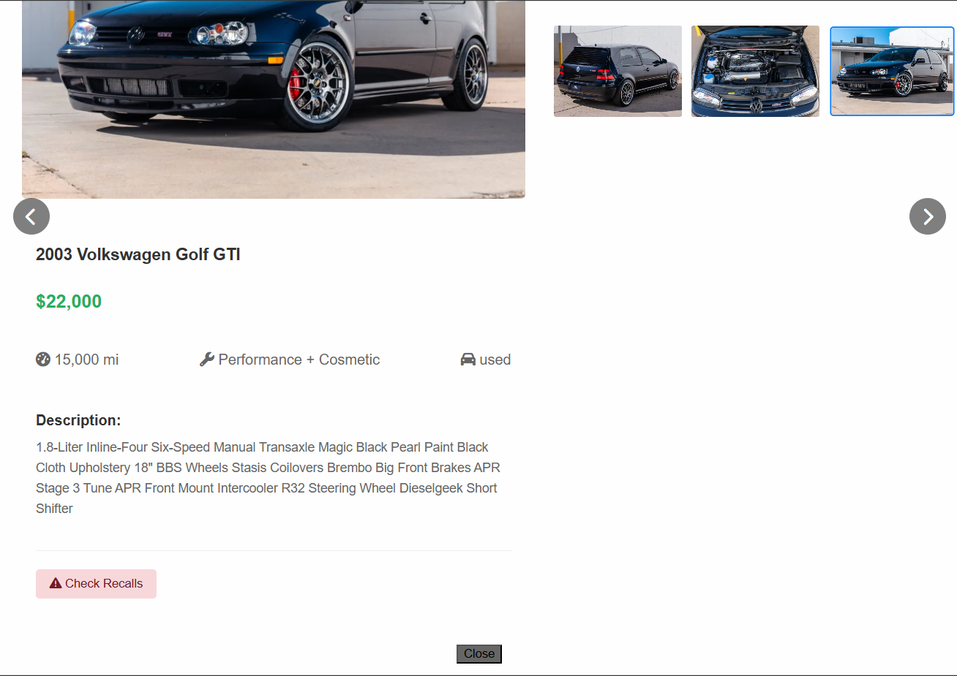
Our Initial Goals VS. Results
Our goal was to build a functional, niche marketplace. Unlike generic car-selling platforms, we wanted to create a specialized hub for German modded cars, where enthusiasts could buy, sell, and showcase builds with full transparency.
Initial Planned Components:
Search filters for brands, models, years, and pricing
A messaging system for sellers and buyers to communicate about listings
User profiles to view more information regarding buyers and sellers.
Actual Working Components:
Functional search & filtering based on car make, model, year, and price (e.g., finding only 2006 BMWs)
Sell your modded car form with step-by-step submission with fields for make, model, year, price, mileage, condition, mod type, description section, and photo upload
Car listings displaying everything inputted into the sell your car form along with recall history.
Recall API that finds the listed car and outputs its recall history
Dashboard for logged in users to manage listings, save listings, manage account, and (future remediation) messaging system

Slide 7

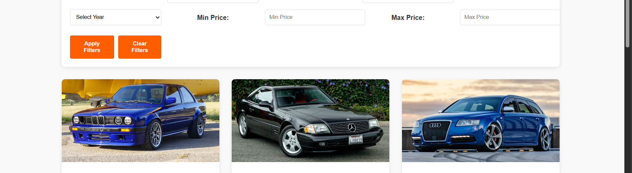
How We Worked Through It
Project Management Insights
The "Car of the Day" feature was abandoned after realizing its complexity, but we implemented something even more beneficial for users anyway, the recall history.
Focusing on core features (listings, auth) first proved more valuable than auxiliary ideas.
Switching from SQL to SQLite3 accelerated deployment, underscoring the need for flexibility.
Personal Growth
Breaking tasks into sections (e.g., "authentication before listings") kept progress steady.
Learning to pivot from failed features (e.g., messaging) to polish essential functionality.

Slide 8
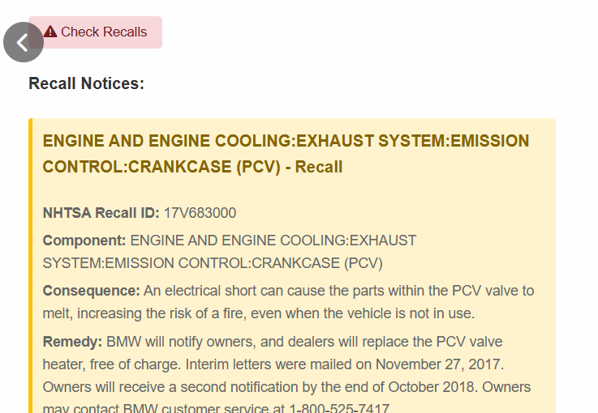
Challenges
Replit Limitations: Collaboration was tricky—Git helped but merge conflicts slowed progress.
API Pitfalls: Learned to validate external API responses (NHTSA sometimes returned null data).
Google AuthO: Though it is fully functional, it currently requires an addition of user URIs within Google Cloud to be functional for everyone. Future remediations, and if we post our site to the public, we will switch to domain for the AuthO to work for anyone, regardless if they have an authorized URI.
Database Trade-offs: SQLite3 was easier to deploy but lacked advanced SQL features.
Git Collaboration: Managing branches/merges was harder than expected (e.g., overwriting fixes).
Scope Creep: "Car of the Day" seemed simple but derailed priorities—better to prototype first.

Slide 9
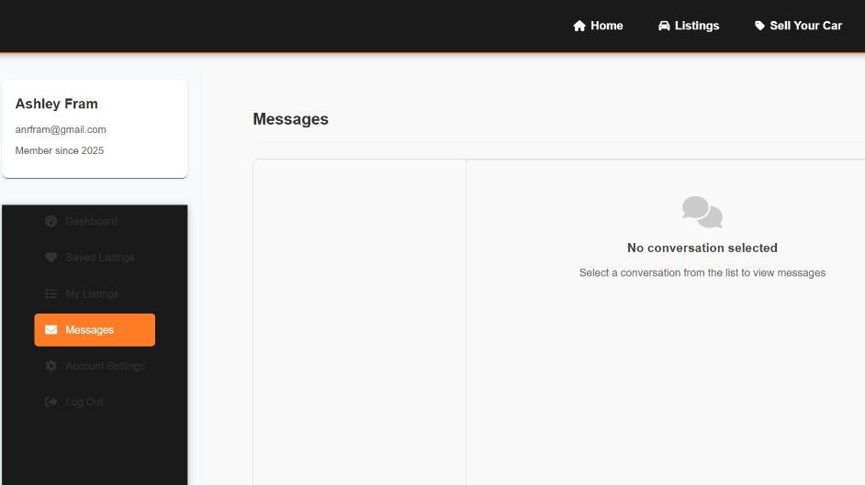
Future Remediations
Messaging System
Switch AuthO to doamin not URI based
Implement real-time chats to enable buyer-seller negotiations.
UI/UX Refinements
Enhance CSS/styles for visual appeal (e.g., card hover effects, mobile responsiveness).
Add interactive elements (e.g., mod galleries, comparison tools).
Scalability Upgrades
Migrate to PostgreSQL for larger datasets.
Community Features
User reviews/ratings for sellers.
A "Build Threads" section to showcase modification progress.

Slide 10
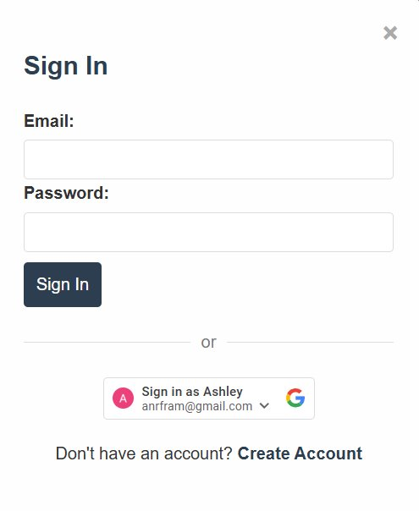
Lessons learned
Switching from SQL to SQLite3 simplified deployment, proving that adaptability is critical.
Git mitigated Replit’s collaboration flaws but required discipline to avoid merge issues.
Polishing core features (APIs, listings, auth) mattered more than auxiliary ideas (e.g., car of the day).

